Slide 1





Phenotyping to omic plant data organization and description using MIAPPE and ontologies
FAIR-ification of Plant Genotyping Data and its linking to Phenotyping using ELIXIR Platforms
Cyril Pommier
Célia Michotey, Anne Françoise Adam Blondon
14 Jan 2018

Slide 2
Overview
Plant Phenotyping standards
MIAPPE overview
MIAPPE for omic data

Slide 3
Plant Phenotyping standards: WHY

Slide 4
Why should we standardize phenotyping data?
To enable anyone (including yourself) to reuse it: metadata about the experiment (who did it, for what purpose, where and how)
To enable the (automatic) integration with other types of data: Linked data between datasets using identification of pivot objects
Phenotype 1 = measurement on a cultivar in an environment-GPS1-time1
Phenotype 2 = measurement on a cultivar in an environment-GPS2-time2
Genotype = observed marker’s alleles on a cultivar
Climate 1 = climatic data at GPS1-time1
To enable knowledge discovery: metadata about the experiment, controlled vocabularies, ontologies

Slide 5

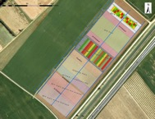
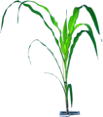
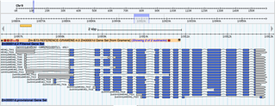
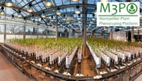


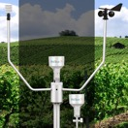
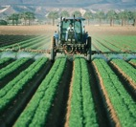
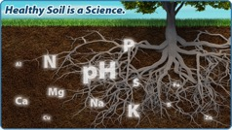
Genome / Environment / Phenome
Genetics & Genomics
Phenomics
Plant Breeding
Genetic variations by Traits
Homogenous (Mostly)
Central Access (Mostly)
Heterogenous
Distributed
Climate Change Studies
Genotype by Environment
Phenology
Environment
Heterogenous
Distributed

Slide 6


Europe open access and interoperability policy
Open Access
FAIR
“Facilitating access to results encourages the re-use of research outputs and supports Open Science. This is essential for Europe's ability to enhance its economic performance and improve the capacity to compete through knowledge. […] Results of publicly-funded research can therefore be disseminated more broadly and faster, to the benefit of researchers, innovative industry and citizens.
All funded projects are asked to add a WP supporting a FAIR compliant Data Management Plan

Slide 7
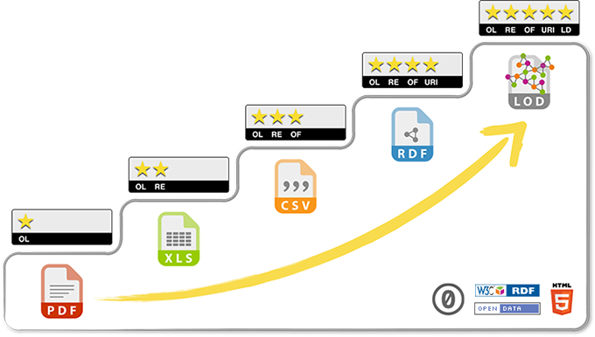
5 stars Open Data
related to other data
identified by URI
non-proprietary format
in a structured format
Data on the web, open licence
Progressing towards FAIR and Open Data requires a multidisciplinary cooperation :
Biologists
Bioinformaticians
Specialists of ontologies/semantics

Slide 8
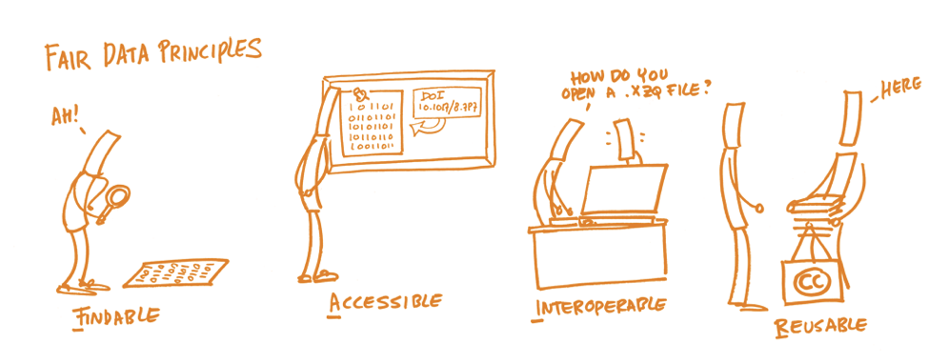
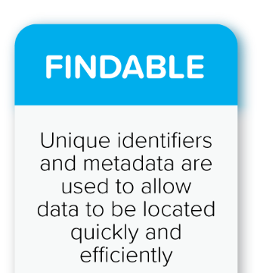

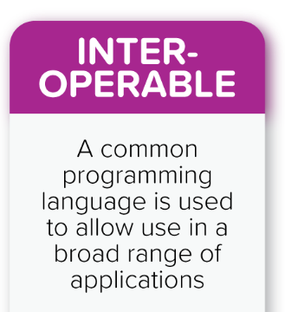
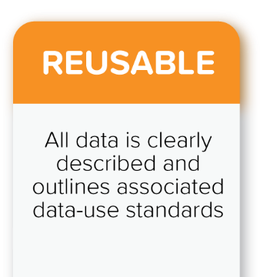

FAIR Data Principles
Wilkinson et al., The FAIR Guiding Principles for scientific data management and stewardship. Scientific Data 3 (2016)
License
Well described
Provenance
Standards
Ids
Metadata
Index
Open Protocole
Perenial Metadata
Semantics
Linked Data
Vocabularies

Slide 9
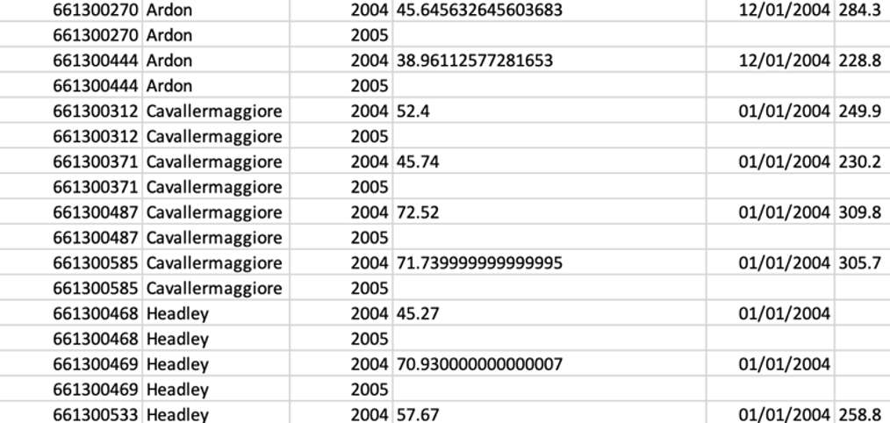
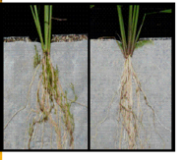
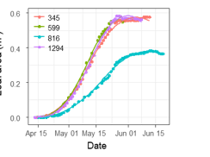
Phenotyping data life cycle
« Raw » data, pheno/env measures, variables
« computed » data, reduced, indicators
Soissons x high N
Charger x high N
Charger x low input
Soissons x high N
Charger x high N
Soissons x low input
Soissons x low input
Soissons x high N
Soissons x low input
Charger x low input
Charger x high N
Soissons x high N
Soissons x high N
Genotype | Treatment | N input | Date | Rep | Fusariose
Soissons | low input | 15,32253129 | 15/11/2011 | 1 | 5
Soissons | low input | 15,31430556 | 16/11/2011 | 2 | 7
Genotype | Treatment | Fusariose
Soissons | low input | 6

Slide 10
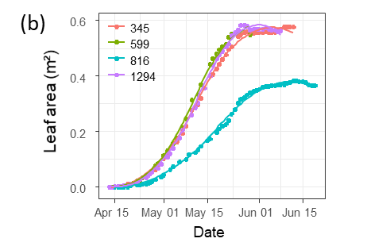
Plant Phenotyping Life cycle
Raw data long term conservation
Data acquisition
Traceability
Data computation
New computation for each scientific question
Data publication
One Data Publication by datasets.
Raw measures
Data Cleaning
Platform IS (Emphasis IS, PHIS, …)
One raw dataset → many computed datasets
Platform IS
FAIR Data Repositories
Reproducibility
Traceability
Provenance
Reduced
phenomic
VARIABLES
INDICATORS
Genotype | traitement | Fusariose
Soisson | low input | 5
Soisson | high N | 7
Charger | low input | 1
Charger | high N | 2
Variety charger is resistant to fusariose under intensiv cultural practice
Data
Knowledge
Notes:
Keep this one

Slide 11





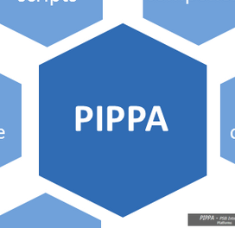

Challenges for phenomics data
Findable
Accessible
Interoperable
Distributed model: no central phenomic data archive
Agreed or compatible ID and Metadata policy
Reusable
Complex life cycle
Complex DMP
Compatible standards
Issues in relation with big data
P = G x E x C => different silos of data & metadata
Provenance is complex
Data portals
Data Archives
MCPD
Platform IS
…

Slide 12
Plant Data StandardS : WHO

Slide 13










Interoperability in International network
National
Networks
European
Networks
Global Networks
International data standards
Web services
Minimal information
Controlled vocabularies
Trait dictionaries
MCPD
Notes:
13

Slide 14
Plant data standards contributors
Gathered to solve interoperability standard problem
ELIXIR
European Infrastructure for life sciences
Germany, France, Belgium, Italy, Portugal, UK, Netherland, Slovenia, …
https://elixir-europe.org/communities/plant-sciences
CGIAR
Consortium of International Agricultural Research Centers
https://www.cgiar.org/
EMPHASIS
European Infrastructure for Plant Phenotyping
France, Germany, Belgium, UK, …
https://www.plant-phenotyping.eu
NAPPN
North American Plant Phenotyping Network
https://nappn.plant-phenotyping.org/

Slide 15
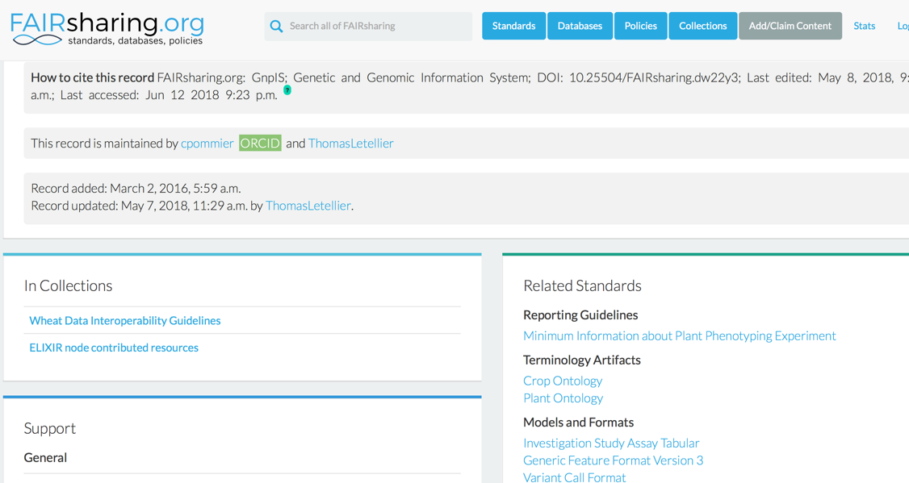
Sharing standards: standards registries

Slide 16
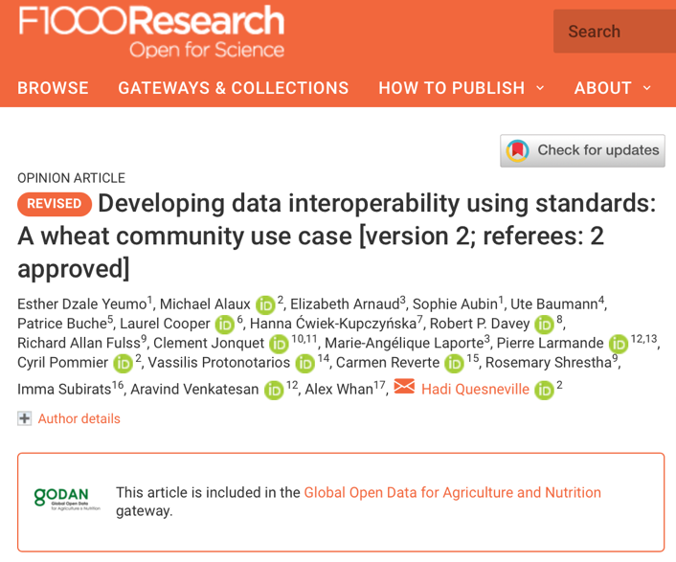
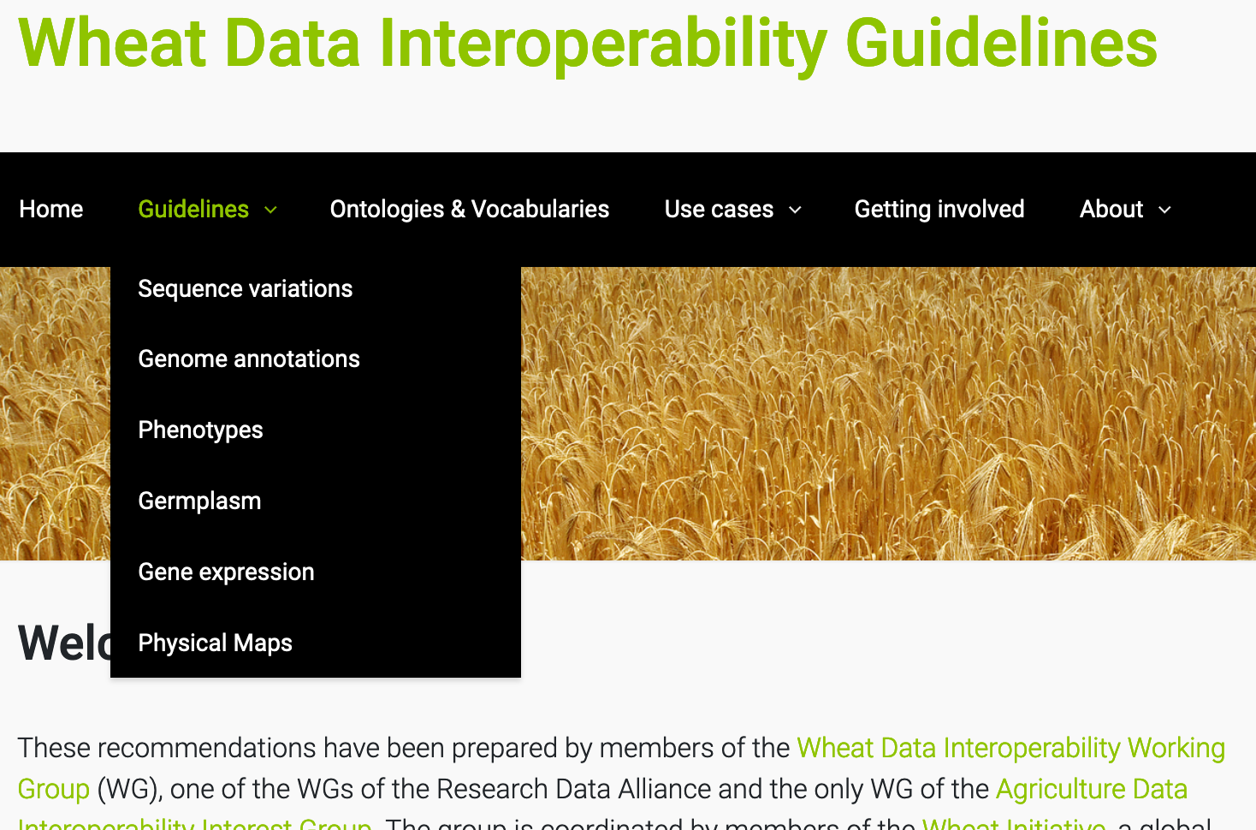
Community driven recomendations
WheatIS: http://wheatis.org/DataStandards.php
Community story

Slide 17
Plant Data StandardS : WHAT

Slide 18




Data standards for FAIR
Structure
Formatting and Organizing the data
Data Models
Standards : CSV, VCF, GFF, MIAPPE (www.miappe.org) , etc…
Biologist & Computer scientist driven
Semantic
Description of the data
Controlled vocabularies: term name and definitions
Ontologies: semantic links between terms
Biologist driven
Persistent Unique Identifiers
URI, gene ID, accessions ID, Trait ID, DOI,…
Technical
Data integration and sharing
Interoperability : tools and systems
GA4GH
Breeding API www.brapi.org
Computer scientist driven

Slide 19



Phenotype Semantic Standard: Ontologies
Describing traits/features in specific plant species
Crop Ontology Trait + Method + Scale Semantic model
TRAIT = Entity + Characteristic
EMPHASIS variables

Slide 20

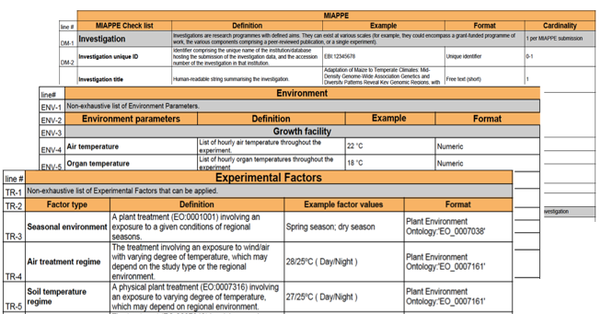
Plant Structure Standard
Minimal Information About Plant Phenotyping Experiment : version 1.1 (Jan 2019)
www.miappe.org
Many stakeholders
Elixir, Emphasis, Bioversity, North American PPN
Open Community:
Request for comments
Github Feature requests
Mailing lists
Meetings & Workgroups
Crops and woody plants
Papoutsoglou et al. (2020) Enabling reusability and interoperability of plant phenomic datasets with MIAPPE 1.1. New Phytol, 227:260-273; https://doi.org/10.1111/nph.16544

Slide 21
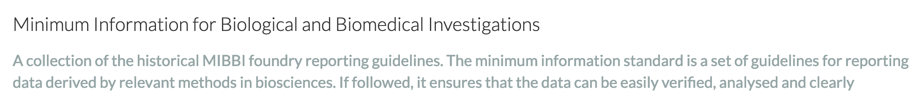
Plant Structure Standard : MIAPPE
Biologist Friendly
Clear definitions and examples
Excel templates
Trainings
Minimal and sufficient list of metadata:
The objective of the experiment
Who contributed to the experiment
What were the experimental procedures
What was the biological material experimented
...

Slide 22

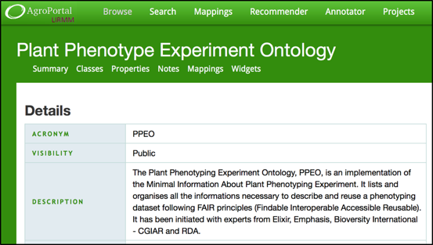




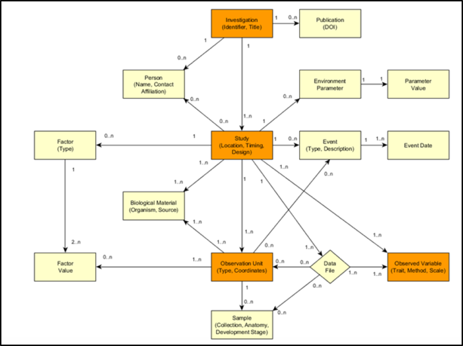
Plant Structure Standard
Computer scientist friendly :
Explicit Data Model: ISA-Tools and Breeding API (BrAPI) compatibility.
Validation framework and toolbox
Specification with multiple implementations
Semantic: Plant Phenotyping Experiment Ontology
Web Service: Breeding API
File Archive: ISA Tab

Slide 23
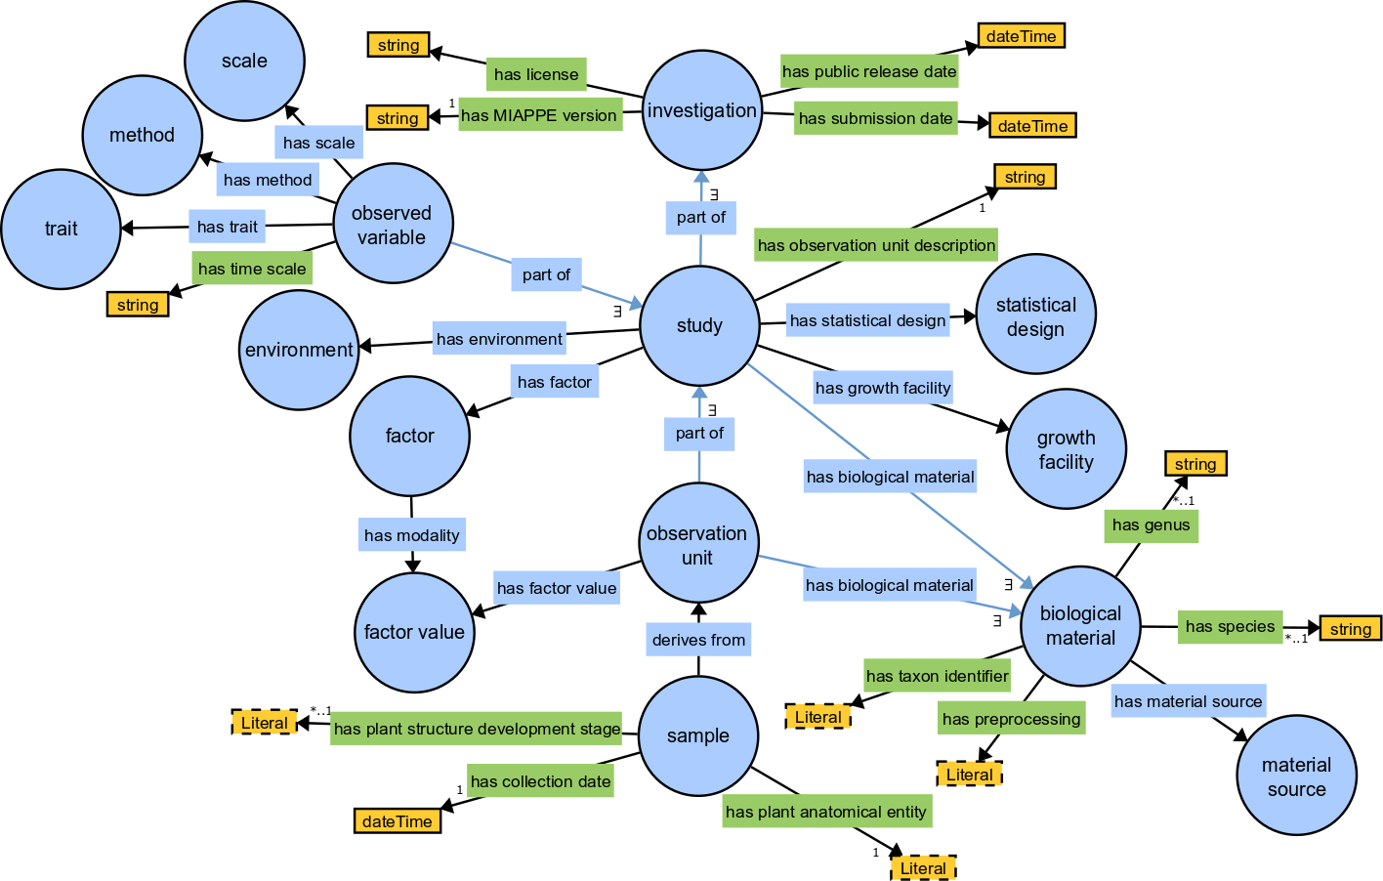
MIAPPE Semantic: PPEO
MIAPPE OWL Implementation
https://github.com/MIAPPE/MIAPPE-ontology
http://agroportal.lirmm.fr/ontologies/PPEO
Data model representation
Formal concepts and constraints
Ontology for Computer scientists, not for biologists

Slide 24
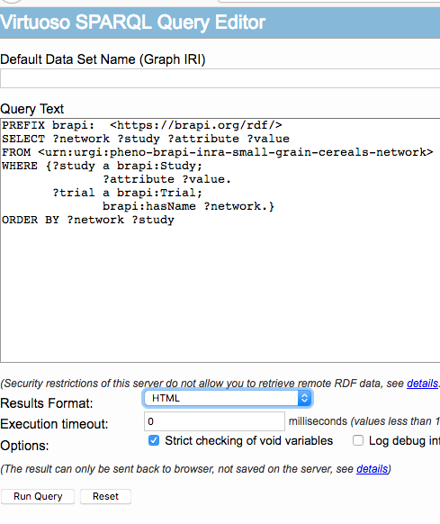
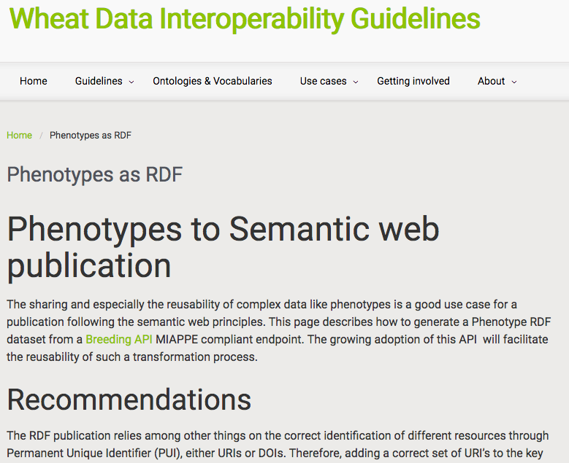
MIAPPE Semantic: PPEO
Brapi 2 MIAPPE RDF workflow
http://ist.blogs.inra.fr/wdi/phenotypes-as-rdf/ (www.wheatIS.org data standards)
JSON LD based
Plant BrAPI ETL FAIDARE: needs update to BrAPI v1.3
https://github.com/elixir-europe/plant-brapi-etl-faidare
Wheat dataset
http://dx.doi.org/10.15454/1.4489666216568333E12

Slide 25









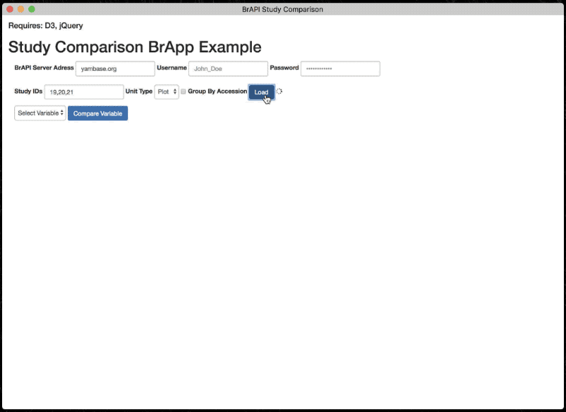
Plant Technical Standard
Breeding API http://brapi.org/
International collaboration
Standard Open Web Service API
Information Exchange, Main target: Breeding
Excellence in Breeding platform (CGIAR, Peter Selby)
Major Elixir, Emphasis Contribution
Phenotyping specification
Connect data repositories and tools:
Genotype visualization (Flapjack)
Studies graph preview and filtering
BrAPPS : Tools integrable in any BrAPI compliant System
https://www.brapi.org/brapps.php
R analysis environment
Field data capture
FAIR Data discovery → Elixir FAIDARE
T3
CIRAD
GOBII
Wageningen
Cornell
iPlant
Selby et al. Bioinformatics (2019),
doi.org/10.1093/bioinformatics/btz190

Slide 26
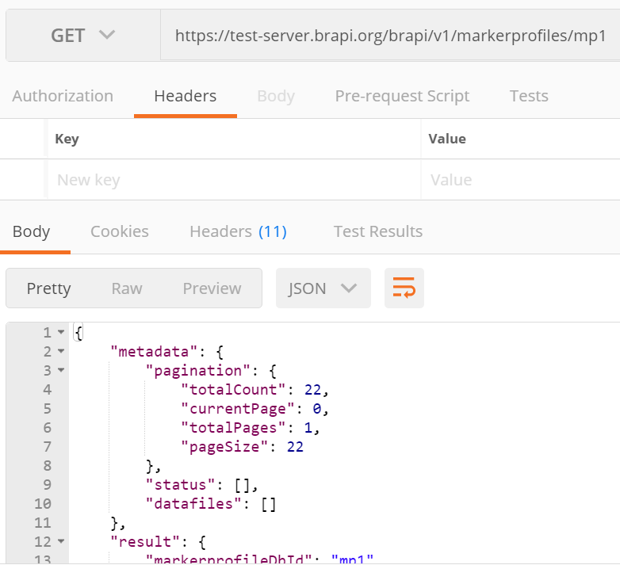
REST - Representational State Transfer
REST is an architecture design for creating Web Services using the well known HTTP standard
Requests are made with URLs
Data is represented with JSON
BrAPI 101 Slides, P. Selby

Slide 27
Standardized Specification
BrAPI has defined a Standardized set of data model structures to communicate the basic information of plant breeding
BrAPI is a technical Specification which software developers can easily turn into code which communicates using the Standard.
BrAPI 101 Slides, P. Selby

Slide 28

BrAPI data model
MIAPPE compliant
MIAPPE Investigation → BrAPI Trial
MIAPPE Study → BrAPI Study
Biological Material Germplasm MCPD dedicated BrAPI calls
Observation variable BrAPI calls
Datafile or Observation Unit
Phenotyping
Studies
Genotyping
Studies
Germplasm
Permanent Unique Identifier (DOI)
AccessionNumber
Taxon
Institute (→ Namespace)
Observation Units
(Plants, Plots, …)
Observations
(Env, Pheno, …)
Observation Variables
Trait
Methode
Scale

Slide 29
Data repositories & Data portals
National data repositories opened for collaborators
GnpIS/data.inrae.fr
https://urgi.versailles.inra.fr/Data/Phenotyping/Data-submission
eDal!-PGP
https://edal-pgp.ipk-gatersleben.de/
BrAPI compliant databases
https://www.brapi.org/servers
Emphasis databases
PHIS, PIPPA, …
Data portals
Search over reporitories all over the world
https://urgi.versailles.inra.fr/faidare/
http://wheatis.org/Search.php

Slide 30
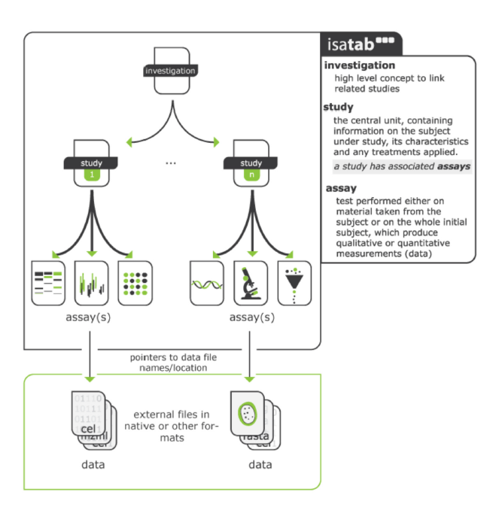
MIAPPE File Archive
ISA Tab for Phenotyping
Investigation/Study/Assay
Zip Archive
MIAPPE Metadata
Raw data
CSV
Images or binary files
Reference to image archive (URI/URL)
Elaborated data
CSV
Provenance
Training and improvements
File and metadata curation
Elixir
Célia Miguel & Anne Françoise Adam Blondon
BrAPI to IsaTab portable tool
Elixir implementation study for MIAPPE Validation
Data files

Slide 31
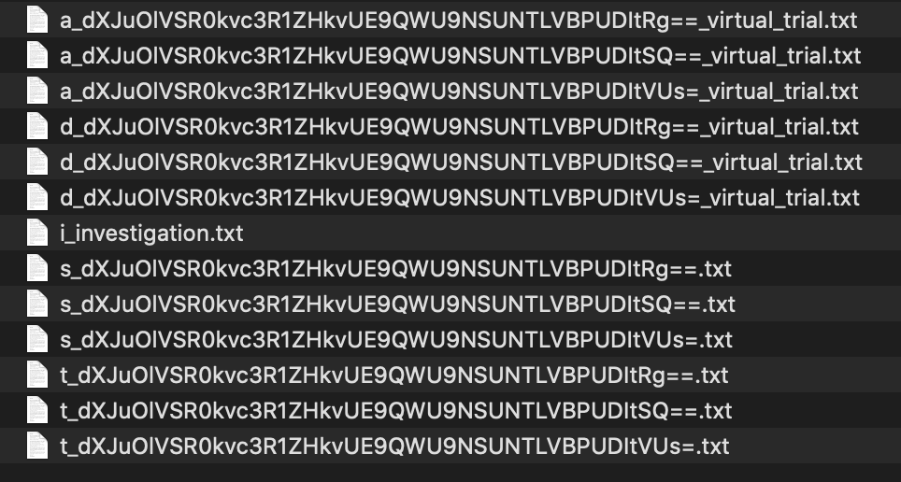
MIAPPE File: Poplar Phenology dataset
Zip archive
1 investigation
i_Investigation.txt : initial file
3 Studies
3 s_*.txt file
1 level per study
3 a_*.txt
3 trait definition file
Crop ontology format
T_*.txt files
3 data files
D_*.txt file

Slide 32
Overview
Plant Phenotyping standards
MIAPPE overview
MIAPPE for omic data

Slide 33
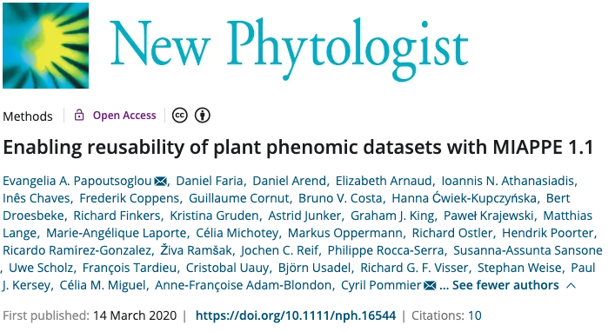
Minimum Information About a plant Phenotyping ExperIMent
MIAPPE Overview and use cases

Slide 34
Capturing important information about phenotyping experiments using the MIAPPE standard
Two examples to illustrate how to capture important information about the phenotyping experiments:
MAIZE: [1] Millet et al. 2019 (https://doi.org/10.15454/IASSTN): A multi-site experiment in a network of European fields for assessing the maize yield response to environmental scenarios.
POPLAR: [2] Monclus et al. 2012 (http://dx.doi.org/10.1186/1471-2229-12-173): Integrating genome annotation and QTL position to identify candidate genes for productivity, architecture and water-use efficiency in Populus spp

Slide 35
Millet et al 2019 [1] - Material&methods section on phenotyping experiments
A panel of 256 maize hybrids was grown with two water regimes (irrigated or rainfed).
Location: seven fields in 2012 and 2013, plus one site in Chile in 2013
This resulted in 29 experiments defined as the combination of one year, one site and one water regime, with two and three repetitions for rainfed and irrigated treatments, respectively.
A detailed environmental characterisation was carried out, with hourly records of micrometeorological data and soil water status, and associated with precise measurement of phenology.
« grain.yield»: yiel adjusted at 15% grain moisture, in ton per hectare (t ha-1). «grain.number»: number of grain per square meter. «grain.weight»: individual grain weight (mg). «anthesis»: male flowering (pollen shed), in thermal time cumulated since emergence (d20°C). «silking»: female flowering (silking emergence), in thermal time cumulated since emergence (d20°C). «plant.height»: plant height, from ground level to the base of the flag leaf (highest) leaf (cm). «tassel.height»: plant height including tassel, from ground level to the highest point of the tassel (cm). «ear.height»: ear insertion height, from ground level to ligule of the highest ear leaf (cm).

Slide 36
Monclus et al 2012 [2] - Material&methods section on phenotyping experiments
3 Field trial established in April 2003 located in France (Ardon, 47°49’41''N, 1°54’39''E, 110 m),Italy Cavallermaggiore ((44° 43' 0'' N) , (7° 41' 0'' E)), UK Headley ((51° 7' 0'' N) , (-1° 10' 0'' W) )
The biological material consisted of a cloned 336 F1 progeny from an interspecific cross between the female Populus deltoides (Bartr. Ex Marsh.) ‘73028-62’ from Illinois and the male P. trichocarpa (Torr. and Gray) ’101-74’ from Washington State.
The trial was established from 25 cm- homogenous hardwood cuttings planted at a plant density of 6670 trees per ha. The trial was and consisted in 6 randomized complete blocks where each F1 genotype and each parent was represented by one replicate.
Circumference and stem height were measured at the end of the first (winter 2003–2004) and second (winter 2004–2005) as described in Dillen et al. Forest Ecol Manag. 2007, 252 (1–3): 12-23). Growth increment in height and circumference during the second growing season were calculated.
Leaf traits where measured in 2003: one fully illuminated mature leaf was collected on each tree according to Monclus et al. http://doi.org/10.1111/j.1469-8137.2005.01407.x ). Six calibrated discs of lamina were cut from this leaf, dried at 50 °C during 48 °C and weighed, and specific leaf area (SLA, cm² g⁻¹) was computed. Leaf discs were ground to fine powder for analysis of leaf carbon isotope composition (δ¹³C), carbon (C_{M}) and nitrogen (N_{M}) contents. One-milligram subsamples of ground material were used for measuring the CO₂ produced by combustion and its ¹³CO₂/¹²CO₂ ratio by a continuous flux isotope ratio mass spectrometer. The discrimination between atmospheric CO₂ and plant material was calculated.

Slide 37
MIAPPE 1.1 Overview
Typical Dataset: Monclus et al., 2012, [2]
Populus deltoïdes
INRA:73028-62
doi:10.15454/1.4921786081024297E12
Data file
Data file
Data file
Data file
6 randomized blocks
1 observation unit = one tree
No treatment
6 replicates defined by their position in each block: row and column

Slide 38
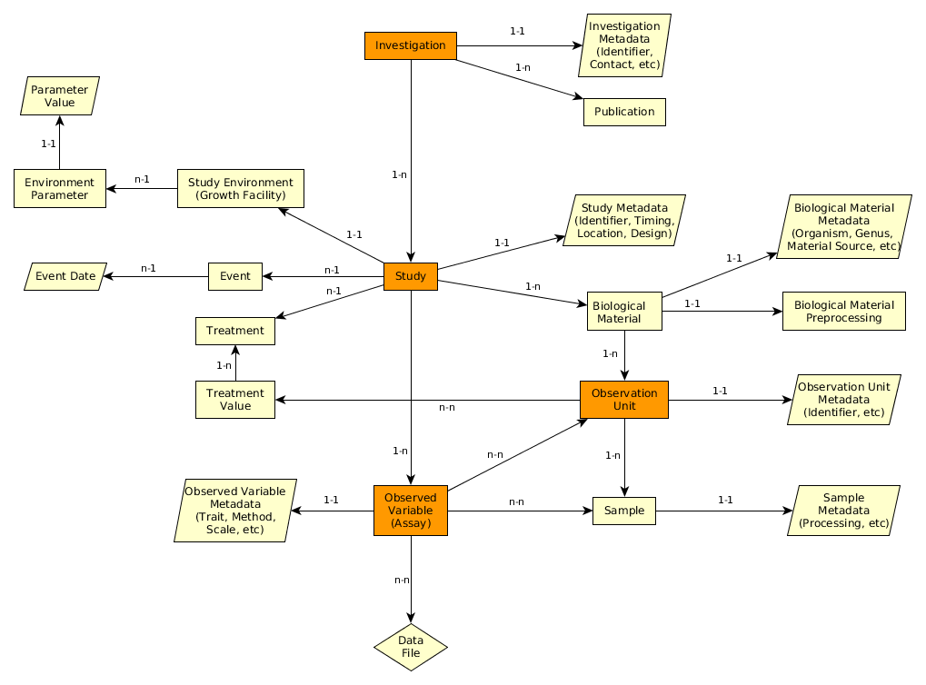
MIAPPE V1.1 Overview the (ISA) backbone
Investigation: whole dataset
Study : one experiment in one location for one to several year
Assay: Level + Trait + Method + Scale/Unit
Level:
Plant
Microplot
Block
Trial
…
Investigation
Study
Assay
(Observed variable)
Data file

Slide 39
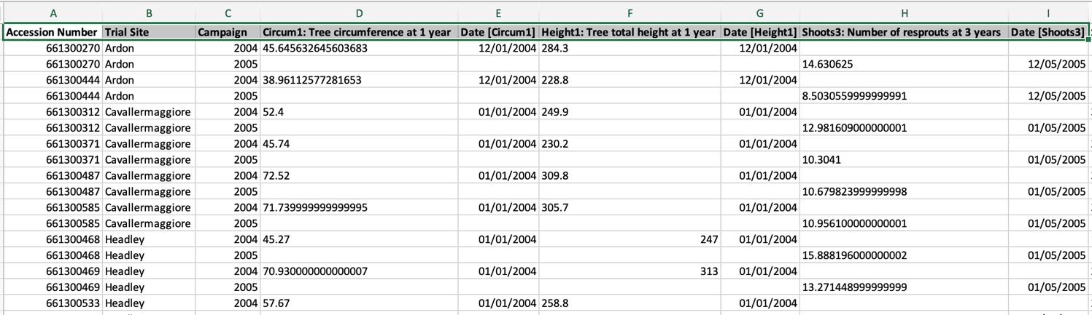
MIAPPE V1.1 Overview Data file content
Any format (Near Infra Red Spectrum, Images, Image Archives references, ….)
Mostly tabular
Metadata on each column header

Slide 40
MIAPPE main sections – Investigation
Investigations are research programmes with defined aims. They can exist at various scales: e.g. grant-funded programme of work with various published components; a single experiment.
One investigation holds one to many studies.
Metadata
Similar to Archive deposition
DOI, title, description, associated publications/people, ...
Examples Investigation :
MAIZE [1]: the whole set of multilocal and pluriannual phenotyping experiments
POPLAR [2]: the whole set of multilocal measurements over three years

Slide 41
MIAPPE main sections – Study
A "study" (or experiment)
One study = one location
comprises a series of assays (or measurements) undertaken to answer a particular biological question.
Metadata
experiment as a whole
timing, location, statistical design, cultural pratices (but not event lists), etc...
Examples of Studies:
MAIZE [1] : 37 studies: year x location x treatment (Gaillac 2012 rain, Gaillac 2013 watered, …)
POPLAR [2] : 3 locations over one to several years (Ardon_2003) (Ardon_2003-2005)

Slide 42
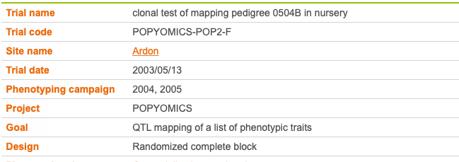
MIAPPE v1.1 Study Metadata
Poplar Study
In that example Study = Trial
Study

Slide 43
MIAPPE main sections – Biological material
Biological material being studied
Plus its source (stock center, gen bank, etc…).
Crucial for integrating phenotyping data with genomic or genetic data.
Metadata
Minimal fields from Multicrop Passport Descriptor (MCPD) standard
GPS location for forest tree / in situ material provenance
Source of the material used: accession, cultivar/variety, region of provenance, laboratory cross, ...
MCPD identification system:
Genebank/Lab + Species + accession number (mandatory)
DOI
Biological material used in the study: seed lot, cuttings…
Lab + internal accession number (mandatory)
URI
Plant Samples used in the study: detached leaves, ...
Lab + internal accession number (mandatory)
BioSample ID

Slide 44
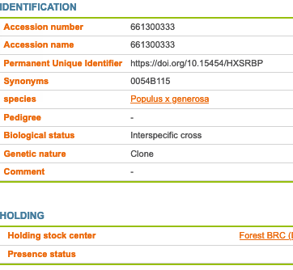
MIAPPE main sections – Biological material
Plant Material
Identification
Description
Multi Crop Passport Descriptor
Biological material
Observation Unit
Sample

Slide 45
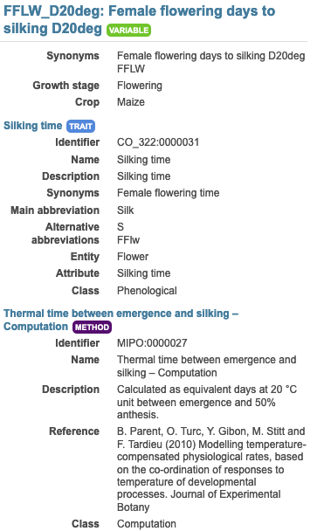
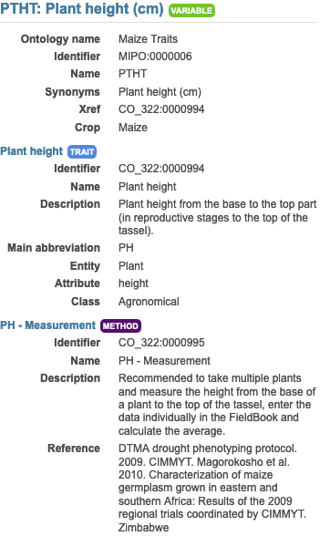
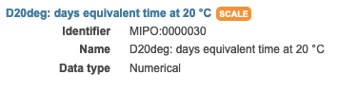
MIAPPE main sections – Observed Variable (Assay)
An Observed Variable (assay)
specific measurement.
Targets a trait
with a method and a scale.
Trait: Phenotype or Environment
Metadata
Crop Ontology Trait Dictionary:
trait, method, scale
Example:
In each study of Millet et al. [1] :
Plant level: 20 variables
Genotype/ Study level: 19 variable both phenotype and environment
Plot level: 9 variables
E.g. Female flowering days to silking D20deg
E.g. Plant height (cm)

Slide 46
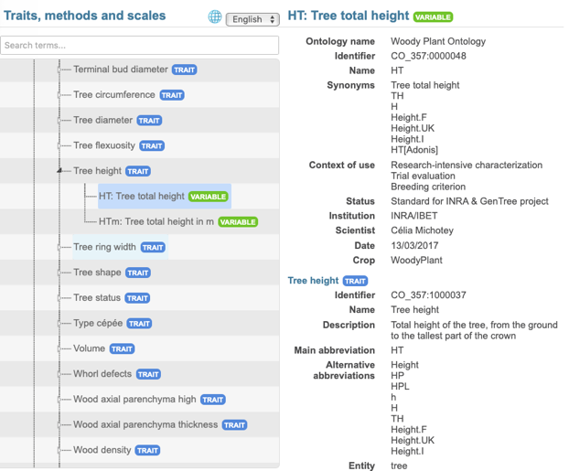
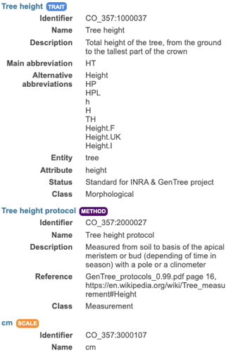
MIAPPE v1.1 Metadata
Observed Variable: Trait + Method + Scale
Assay
(Observed variable)

Slide 47
MIAPPE main sections – Observation Unit, Samples
Observation units
objects in the study
Observations/measures are made on observation units
Treatments values are made on observation units
Also used for environmental variables.
Metadata are specific to MIAPPE: identifiers, location, replication, treatments, …
A sample
portion of plant tissue extracted from an observation unit
sub-plant observations and/or molecular studies.
Metadata : identifiers, information about processing, …

Slide 48
MIAPPE main sections – Observation Unit, Samples
Populus deltoïdes
INRA:73028-62
doi:10.15454/1.4921786081024297E12
Example: Monclus et al., 2012, [2]
6 randomized blocks
1 observation unit = one tree
No treatment
6 replicates defined by their position in each block: row and column

Slide 49
MIAPPE main sections – Observation Unit, Samples
Example: Monclus et al., 2012, [2]
Populus deltoïdes
INRA:73028-62
doi:10.15454/1.4921786081024297E12
[observation unit] : Block1-Row4-Col4
Set of samples
One leaf
For each tree of each block
= for each observation unit
6 leaf disks
Different types of processing of the leaf disks depending on the measurement: can be captured by different sets of samples (e.g. if subsampling generates repetitions) or in the method of the observed variable.
Notes:
Leaf traits where measured in 2003: one fully illuminated mature leaf was collected on each tree according to Monclus et al. http://doi.org/10.1111/j.1469-8137.2005.01407.x ). Six calibrated discs of lamina were cut from this leaf, dried at 50 °C during 48 °C and weighed, and specific leaf area (SLA, cm² g⁻¹) was computed. Leaf discs were ground to fine powder for analysis of leaf carbon isotope composition (δ¹³C), carbon (C_{M}) and nitrogen (N_{M}) contents. One-milligram subsamples of ground material were used for measuring the CO₂ produced by combustion and its ¹³CO₂/¹²CO₂ ratio by a continuous flux isotope ratio mass spectrometer. The discrimination between atmospheric CO₂ and plant material was calculated.

Slide 50
MIAPPE V1.1 data model – Other Important sections
Investigation
Files: data,…
Environment
Events
Study
Biological material
Expe Factor
Observation Unit
Assay
(Observed variable)
Sample

Slide 51
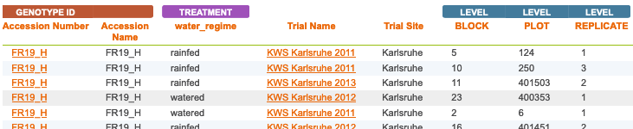
MIAPPE main sections – Experimental Factor
Biotic or abiotic experimental factor
Its effects are evaluated in the study.
Takes different values in the observation units
Metadata: name, description and value
Example : Maize dataset [2]
Two Experimental factors/treatments: Rainfed, Watered
Identified by dedicated metadata
Block organisation
Study the effect of Environment/Drought on the Biological material

Slide 52
MIAPPE main sections – Event
Event
Discrete occurrence at a particular time
Natural, e.g. rain, unwanted pathogen attack
Cultural practice, e.g. planting, watering, etc.
Whole study level or at the observation unit level
It is not the studied Factor but an additional information
Metadata: name, description, time/date
Examples: In Poplar, [2]
the field establishment date, 2003.
the orchard was subjected to 15mm of rain on March 15, 2012 (fiction).
Study | Event
 | Name | Description | Date
Monclus et al., 2012 | Rain | 15mm of rain on the orchard | 2012-03-15

Slide 53
MIAPPE main sections – Environment
Environment parameters
Constant throughout the study
Did not change between observation units or assays.
Environment characteristics that vary over time, i.e. environmental variables, should be recorded as Observed Variables
Metadata :name, value
Example:
Environment parameter | Environment parameter Value
Sowing density | 20 seeds/m2
Rooting medium composition | Ca (XEO:00058): 5 mg/L; ...

Slide 54
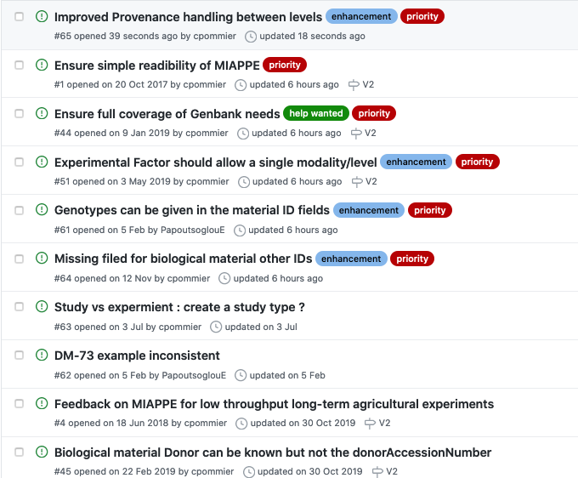
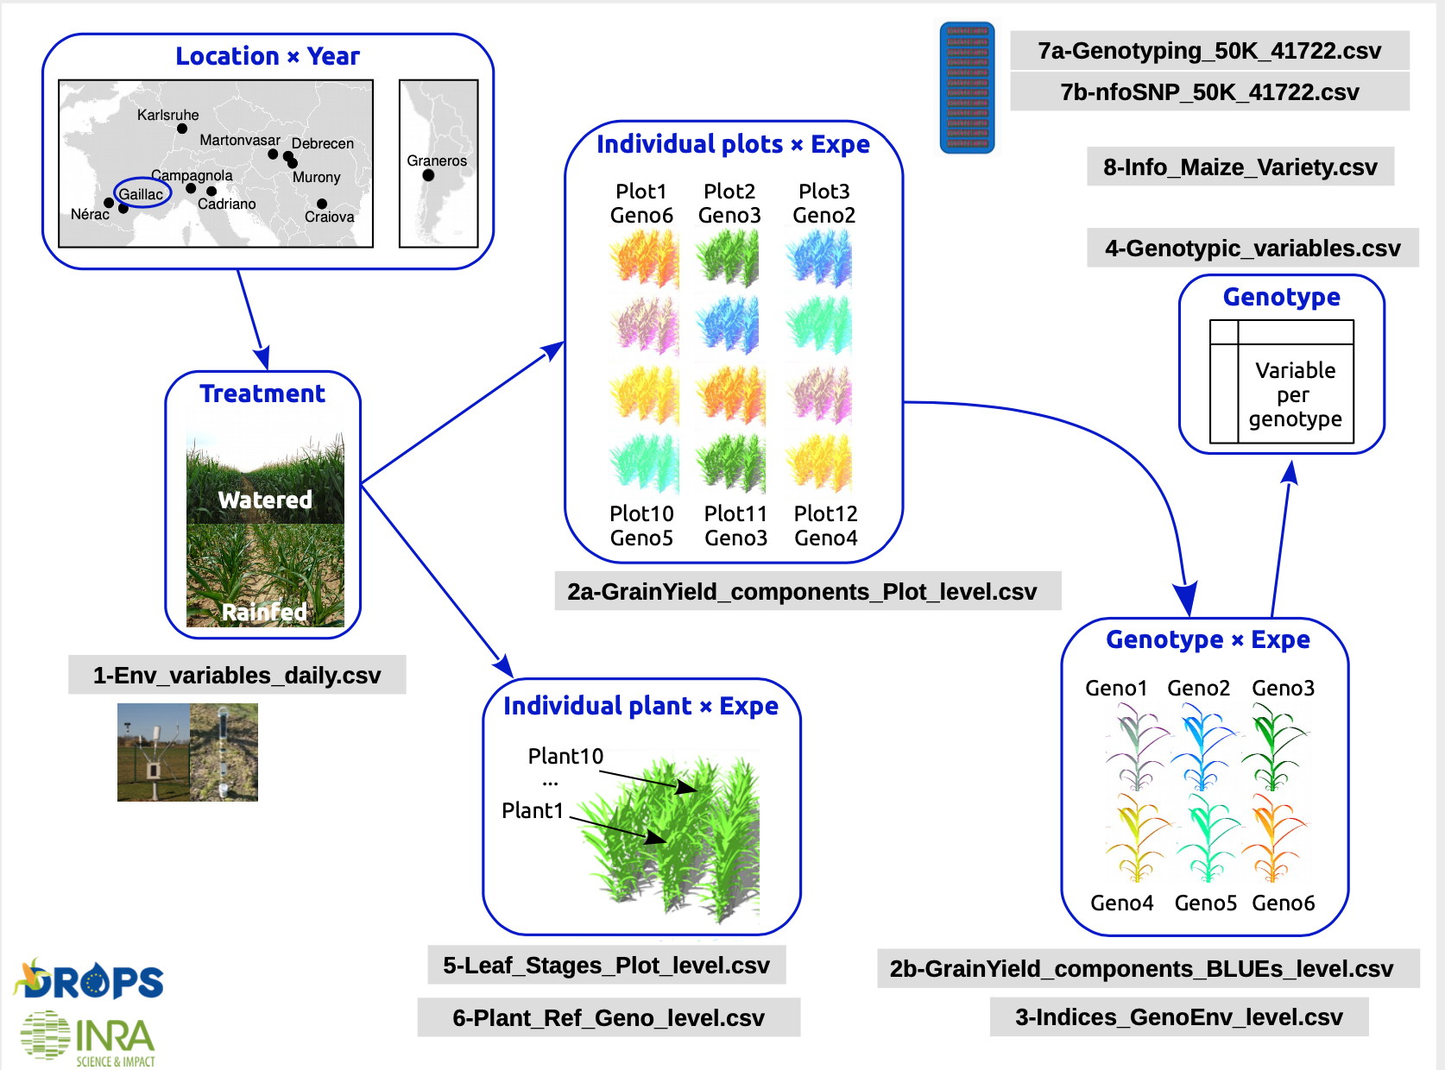
Perspectives
Open community
Github
Mailing list
Outreach
Training
Elixir Service bundles
EMPHASIS contributions

Slide 55
Overview
Plant Phenotyping standards
MIAPPE overview
MIAPPE for omic data

Slide 56
Phenomic to omic : key shared resource / interoperability pivot
Plant material
Source of the material used: accession, cultivar/variety, region of provenance, laboratory cross, ...
Biological material used in the study: seed lot, cuttings…
Plant Samples used in the study: detached leaves, ...

Slide 57
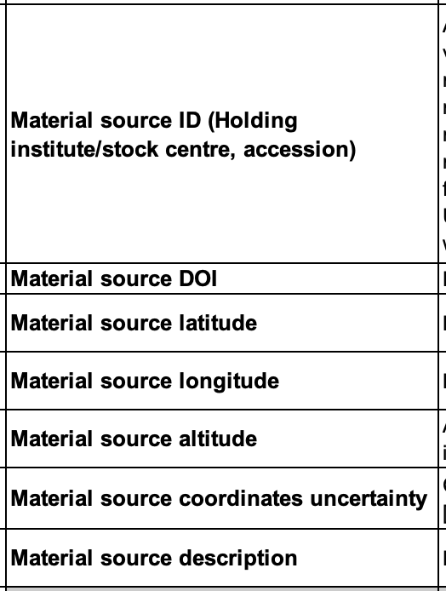
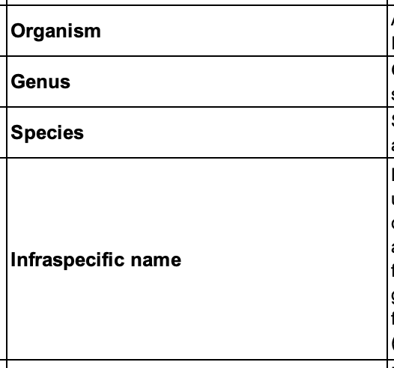
Phenomic to omic : key shared resource / interoperability pivot
Plant material
Source of the material used
Holding + Accession number + taxon
Biological material used in the study: seed lot, cuttings…
Plant Samples used in the study: detached leaves, ...

Slide 58
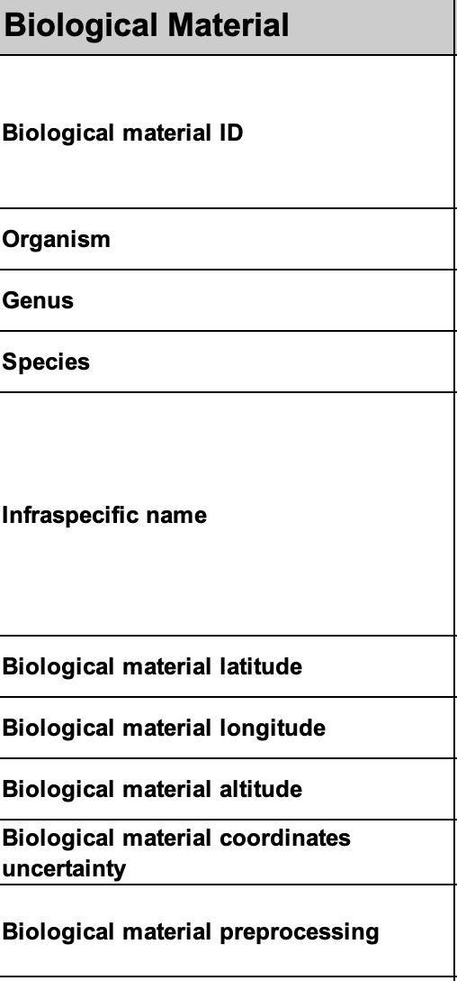
Phenomic to omic : key shared resource / interoperability pivot
Plant material
Source of the material used: accession, cultivar/variety, region of provenance, laboratory cross, ...
Biological material used in the study: seed lot, cuttings…
Plant Samples used in the study: detached leaves, ...

Slide 59
Phenomic to omic : key shared resource / interoperability pivot
Plant material
Source of the material used: accession, cultivar/variety, region of provenance, laboratory cross, ...
Biological material used in the study: seed lot, cuttings…
Plant Samples used in the study: detached leaves, ...

Slide 60

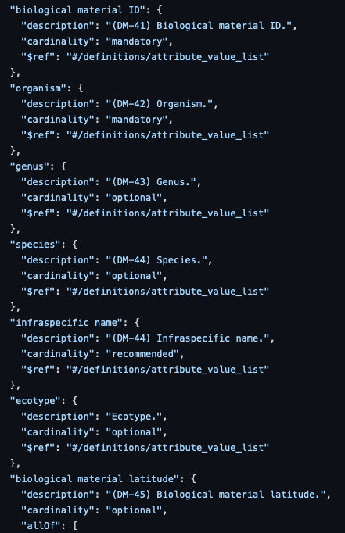


Description of Plant Sample Data
Consolidation with available plant-centric checklists and harmonization with MIAPPE
GSC MIxS plant associated
ENA Crop Plant sample enhanced annotation
ENA Plant Sample
BioSamples Plant-miappe

Slide 61
Plant-miappe.json
Checklist available on github
Fields of interest
"material source ID»: Holding + Accession number + taxon. Plus « material source DOI"
Organism: NCBI, The Plant List, etc…. Genus and Species for uncommon taxons. Stick to species rather than subspecies
infraspecific name: Varieties names, important search criterion
Alternate Ids: to be added soon, project Ids, necessary for interoperability with non EBI databases.

Slide 62
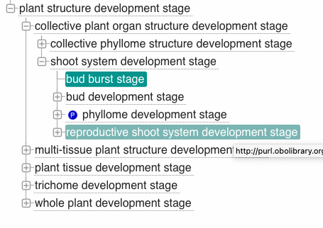
Plant-miappe.json
Fields of interest
"plant structure development stage":
Plant Ontology term (subclass or PO:0009012)
BBCH scale term
"plant anatomical entity »
Plant Ontology term (subclass of PO:0025131)
"sample ID »: for tracability and interoperability with omic analysis center, …

Slide 63
Perspectives
Open community
Github
Mailing list
Outreach
Training
Elixir Service bundles

Slide 64





















Take Home message
Standardizing your data is
Good for you
Good for others
Getting easier
Contribution Welcomed !
Thank you!

